Slide 1
C.R.A.S.H.
Comfort, Reliability And Self Handling
Alexander Badju, Fredrik Helander,
Jonathan Knorn, Jonathan Klingberg,
David Lundberg & Niklas Sjöberg

Slide 2


Slide 3


Slide 4



Slide 5


Slide 6


Slide 7


Slide 8
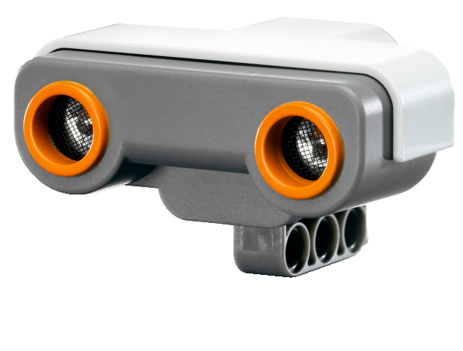


Slide 9


Slide 10
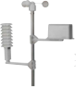

Slide 11
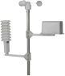


Slide 12
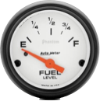

Slide 13


Slide 14



Slide 15
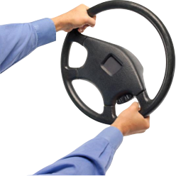

Slide 16


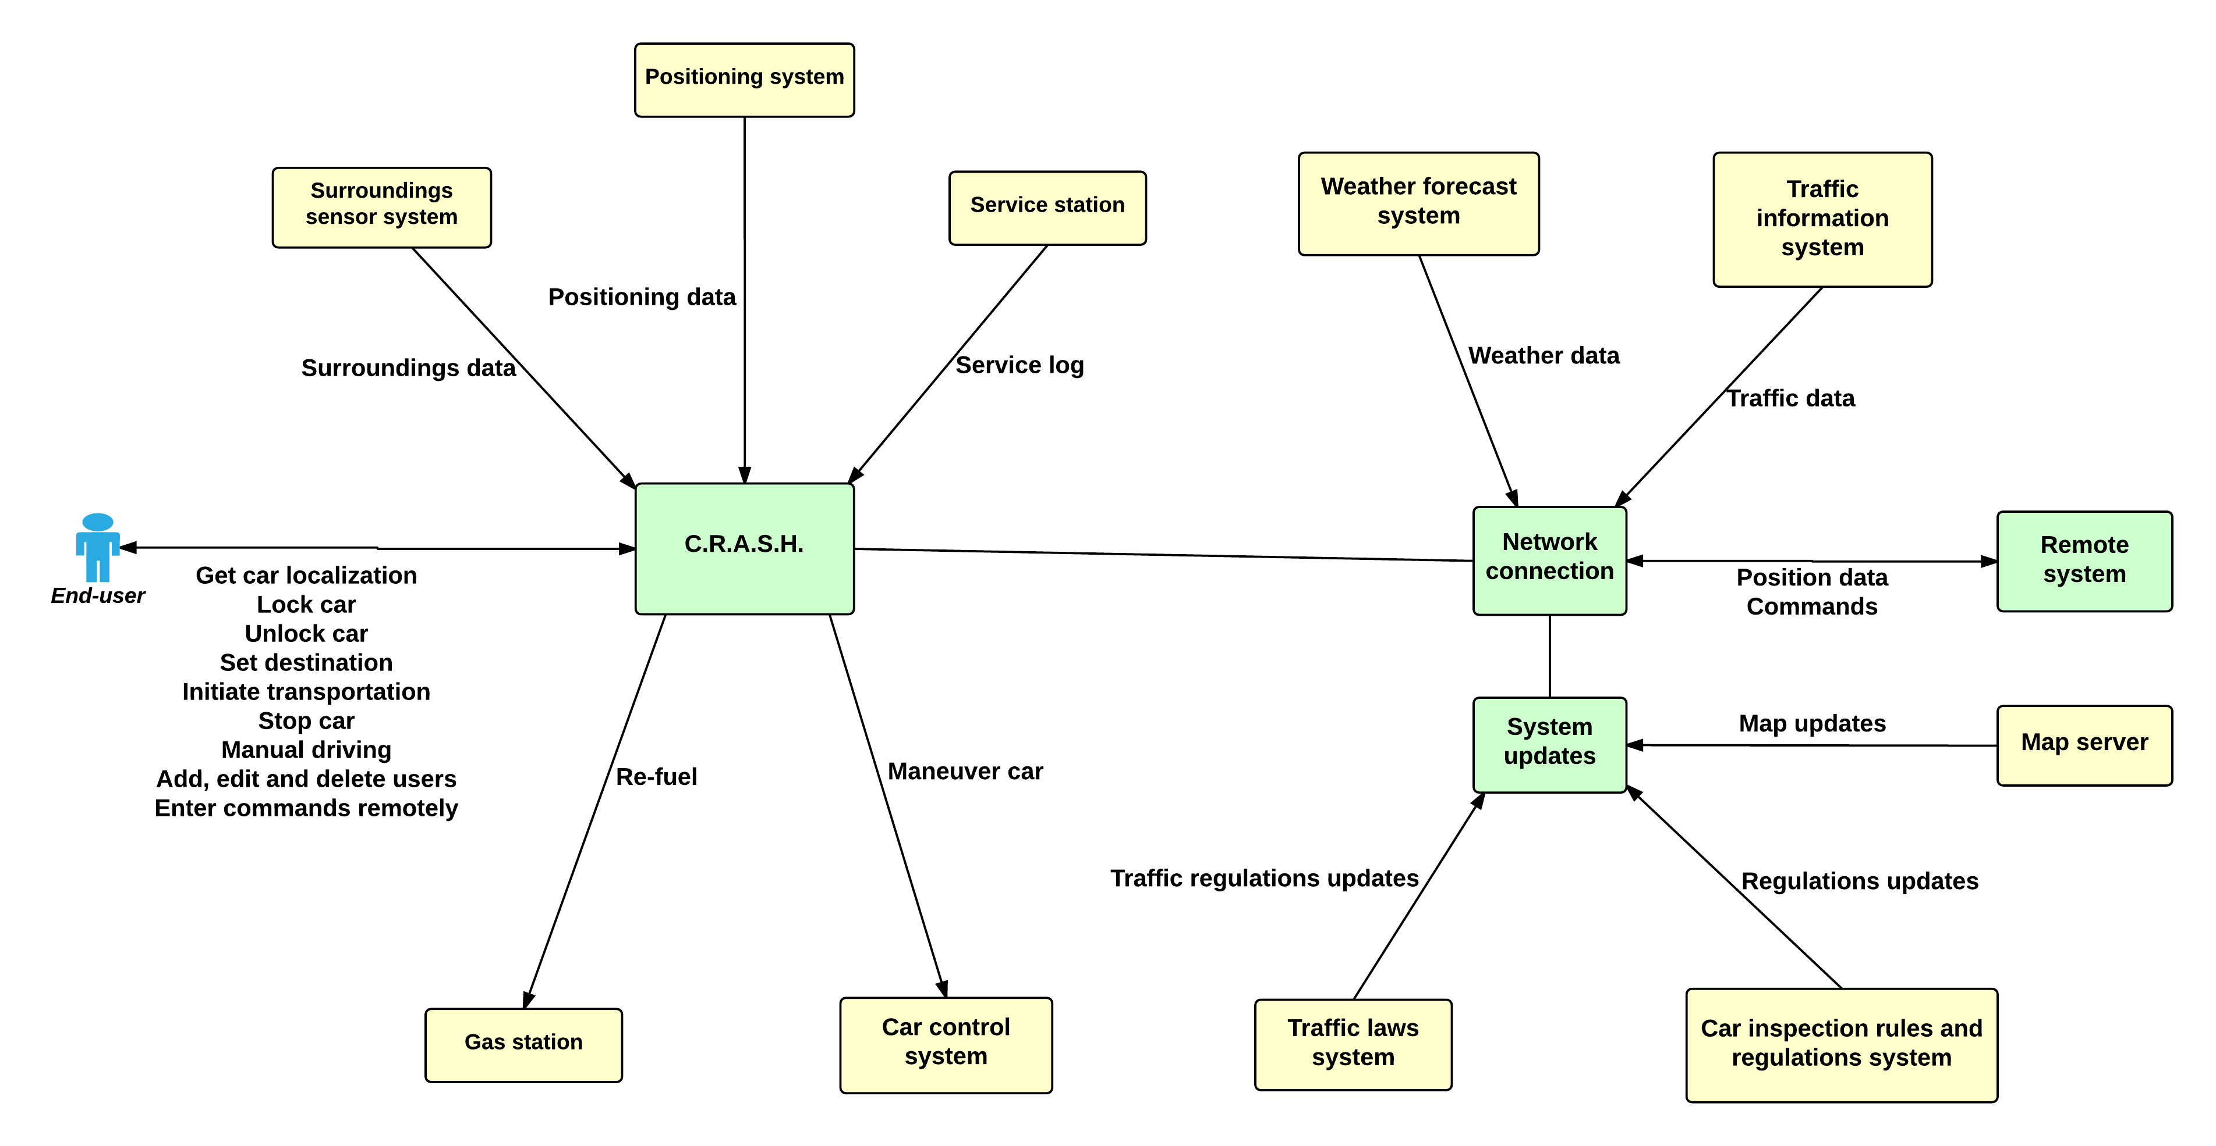

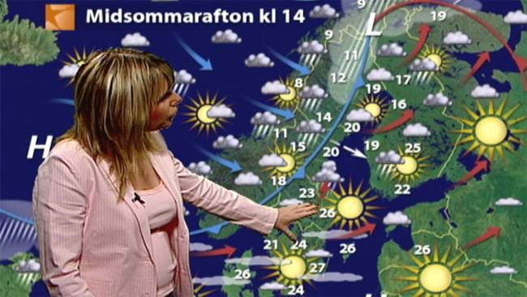
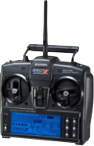





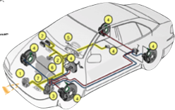


Slide 17
Project Methods
& Experiences

Slide 18
Release 1
Project scope
Elicitation techniques
-Interviewing
-Negotiation
-Brainstorming

Slide 19
Release 2
Walkthrough
Validation checklist

Slide 20
Release 3
Restructure of SRS
Improved categorization of requirements

Slide 21
Tack för oss!

